Slide 1
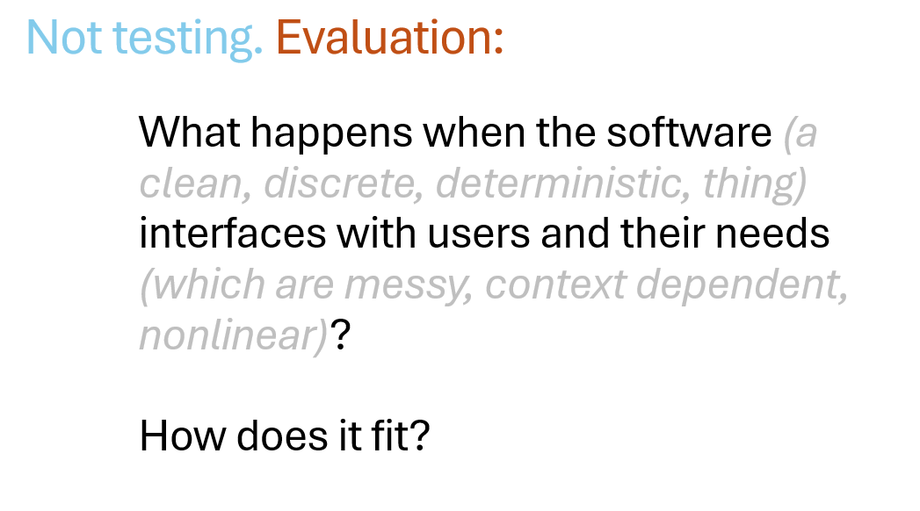
Previously …

Slide 2
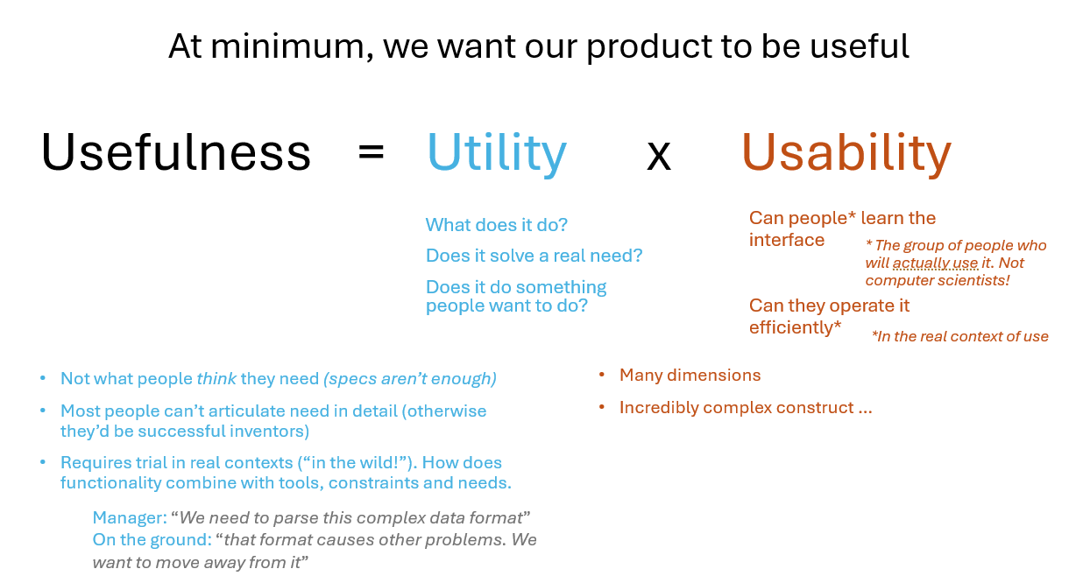

Slide 3
Qualitative
Think Aloud
Task-based Evaluation
Heuristic Evaluation
User Interviews
Quantitative
Time-stamps during task
Error rate
Quantitative Questionnaires

Slide 4
Quantitative Questionnaires
It’s hard to write good questions
Harder still to write good quant questionnaires
Use other peoples’ questionnaires?
  Ideally validated questionnaires
  That measure things useful to understanding the usability issues and successes.

Slide 5


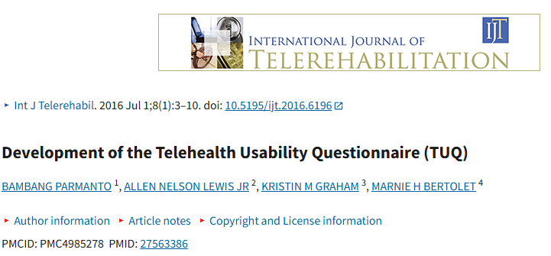
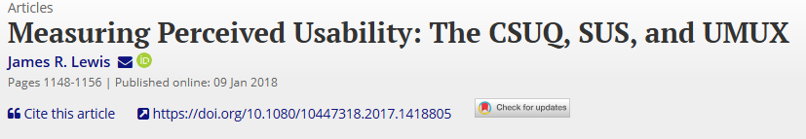
Quantitative Questionnaires
There are many usability and user experience questionnaires
https://playerexperienceinventory.org/

Slide 6
How to choose? And How to use the questionnaires?
Thinking through this via 2 “BIG NAME” questionnaires
NASA-TLX
SUS
For both more details are provided in the workbook on Git Hub

Slide 7
2 “BIG NAME” Quantitative Questionnaires
NASA-TLX (Task Load Index)
Gold standard for measuring subjective workload
Includes mental demands, physical demands, time pressure, frustration, feeling of effort, sense of own performance
As such, it measures some aspects of usability (look back at week 8)
Might this be right for you?

Slide 8
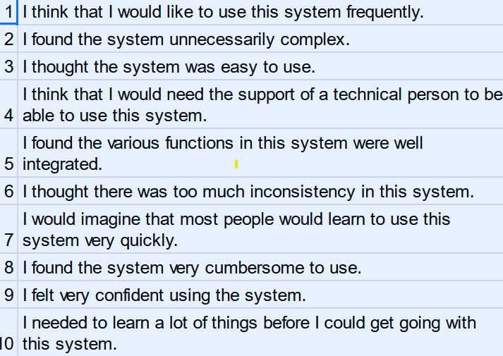
2 “BIG NAME” Quantitative Questionnaires
SUS (System Usability Scale)
A quick and dirty standard measure for usability more broadly
Includes effectiveness, efficiency and satisfaction
Again, it measures some aspects of usability (look back at week 8)
Might this be right for you?

Slide 9
Choosing how to evaluate?
What level of understanding
Identify new issues in a broad manner? (qualitative may be best)
Measure accepted usability factors? (standard usability questionnaires))
Measure VERY specific factors ? (specific measures for e.g. workload, immersion)
What aspects of usability and UX matters in your project?
Efficiency?
User Comfort?
Frustration?
Social acceptance?
Enjoyment?
Immersion?

Slide 10
There are many usability and user experience questionnaires
https://playerexperienceinventory.org/

Slide 11
How to administer?
Again – look at last week’s materials
How do the questionnaires fit into your testing task, alongside e.g. task observation?
Raw numbers are less useful than comparisons
What to compare?
  Different designs of your product?
  Different aspects or parts of the product?
  Different user groups (e.g. skill level?)

Slide 12
How to analyse?
Think back to statistical tests you learned in Maths B
Descriptive statistics: mean and standard deviation
Plotting differences
Inductive tests: t-tests, ANOVA, CHI-squared

Slide 13
Q&A, Reflect on:
What do you want to find out from testing?
What part of your systems(s) will you test?
What methods do you want to use? (ThinkAloud, surveys; will surveys be on paper, digital, questions you ask and record the answers etc)
What questions do you want to ask? What kind of answers will you collect?
How will you demo your product and ask the questions? For example, will you bring your own laptop, or log onto a lab machine? How many people can test it at the same time? What kind of introduction will you have to the project?
Ideally, which space will you want to test in (we have 1.07, 1.15 and the Lower Atrium, but each has a maximum capacity, so we can't guarantee you'll be where you want). If any of your team members have sensitivity issues, and would find it easier to be in a specific space, get in touch with Sarah.

